Slide 1
Resource Hints
Helping the browser make better decisions

Slide 2
Presentation Summary
What are resource hints?
What resource hints are there?
Hints inside of hints
When to use resource hints?

Slide 3
1. What Are Resource Hints?

Slide 4
What are resource hints?
Allow us to help the browser find the resources it will need and download them ahead of time for better performance
If a browser doesn’t support resource hints, it will simply ignore them. So your web page will still load normally.
There are 5 resource hints that can be grouped accordingly:
DNS-specific | Resource-specific | Page-Specific
dns-prefetch | prefetch | prerender
preconnect | preload | -

Slide 5
2. What Resource Hints Are There?

Slide 6
dns-prefetch

Slide 7
What resource hints are there? dns-prefetch
dns-prefetching is the process of initiating the DNS resolution of each domain where a site has hosted resources, before the browser may make a request for them, with the goal to save the DNS resolution time when the resource is needed on the page.
DNS resolution only affects the first resource downloaded from that domain, but it still matters. If you perform a DNS resolution in advance, you’ll save that time and load that resource faster.

Slide 8
dns-prefetch: Benefits
DNS resolution occurs in the background
Save time when new, external resource requested (20-120ms)
Lightweight expense versus opening/keeping connection
Initiate resolution of resources the browser will not be aware of when parsing page
Strong browser support

Slide 9
dns-prefetch: Be aware of
The browser is not required to follow a <link rel=“dns-prefetch”> instruction. This means it can decide not to perform the DNS resolve.
Therefore, pages that use resources must still have <link>’s to those resources.
Using both the dns-prefetch and preconnect tags for the same domain is not useful as preconnect does everything dns-prefetch does and more
Exceptions:
You want to support older browsers (see caniuse.com charts that follow)
You want to speed up more than 4 domains without the expense of opening and keeping a connection

Slide 10
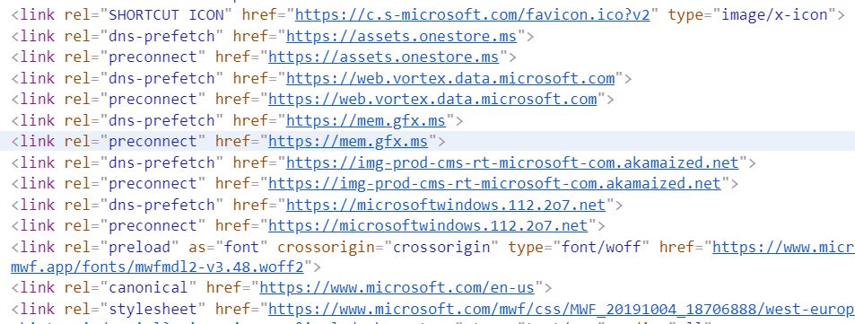
dns-prefetch: dns-prefetch, preconnect Exception Example
Notes:
Example from inspecting the source code for Microsoft.com, which contains five pairs of dns-prefetch/preconnect hints. This likely is to make use of support of Microsoft’s IE9 browser, which is too old to support preconnect hints, but can act on dns-prefetch hints.

Slide 11
dns-prefetch: How it works
<link rel=“dns-prefetch” href=“//example.com”>
URL Encountered
The browser first checks its cache for the domain
Cached copy not found
Domain resolved thru DNS request
Cache primed
Request occurs in background
Domain cached
DNS resolved ahead of time
Notes:
When the browser encounters these URLs, it first checks its cache, and then, lacking a cached copy, resolves the domain to the associated IP address through a request from the DNS server.
These requests happen in the background in a way that doesn’t block the rendering of the page.

Slide 12






dns-prefetch: Example – JavaScript Issue
DNS resolution occurs at runtime
Local DNS cache
api.my-app.com
my-app.com
DNS Resolution
3
2
1
Local DNS cache
api.my-app.com
5
api.my-app.com
6
JavaScript file makes AJAX requests to api.my-app.com
Notes:
While doing speculative parsing, the browser does not execute inline JavaScript blocks. This means that it won’t discover any script-injected resources while parsing the page.
In this example, the app is hosted at my-app.com, and it makes AJAX requests to api.my-app.com. The browser doesn’t know that you’ll be making requests to that domain – because you make them from JavaScript.
If there is no data for the domain and its IP address in the local DNS cache and the operating system’s hosts file, the local DNS client sends a query to the DNS resolvers, specified in the operating system’s network connectivity settings.

Slide 13
dns-prefetch: Example – JavaScript Resolution
my-app.com
DNS resolution occurs during parsing of HTML
Local DNS cache
api.my-app.com
1
DNS Resolution
HTML contains,
<link rel=“dns-prefetch” href=“api.my-app.com” />
2
3
Local DNS cache
api.my-app.com
4
JavaScript file makes AJAX requests to api.my-app.com
5
api.my-app.com
6
Notes:
The app is hosted at my-app.com, and it makes AJAX requests to api.my-app.com. The browser doesn’t know that you’ll be making requests to that domain – because you make them from JavaScript. When the browser encounters these URLs, it first checks its cache and then, lacking a cached copy, resolves the domain to the associated IP address through a request from the DNS server. These requests happen in the background in a way that doesn’t block the rendering of the page.

Slide 14
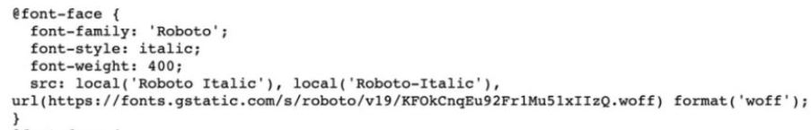
dns-prefetch: Example – Google Fonts Issue part I
my-app.com, CSS file uses Google Font, Roboto
Local DNS cache
fonts.googleapis.com
DNS resolution occurs at runtime
4
DNS Resolution
1
2
Local DNS cache
api.my-app.com
HTML file
fonts.googleapis.com
5
6
contains, <link rel="stylesheet"> href="https://fonts.googleapis.com/css?family=Roboto:400,400i,700"
8
7
Notes:
The app is hosted at my-app.com, and it uses Google Fonts. Google Fonts load fonts in two stages. First, a CSS file is downloaded from fonts.googleapis.com.
If you look at the Google Fonts embedded code it appears to be a single HTTP request. However, if we visit that URL we can see there are three more requests to a different URL, https://fonts.gstatic.com. One additional request for each font variant.

Slide 15
dns-prefetch: Example – Google Fonts Issue part II
DNS resolution occurs at runtime
my-app.com, CSS file uses Google Font, Roboto
Local DNS cache
fonts.gstatic.com
DNS Resolution
@font-face {…
url(https://fonts.gstatic.com)..}
2
3
Local DNS cache
api.my-app.com
1
HTML file
4
5
WOFF file
fonts.gstatic.com
8
6
7
Notes:
The CSS payload from fonts.google.com has been received from the first state.
The second stage involves CSS file requests fonts to fonts.gstatic.com. One additional request for each font variant. The problem with these additional requests is that the browser won’t begin the processes to make them until the first request to https://fonts.googleapis.com/css is complete.

Slide 16
dns-prefetch: Example – Google Fonts Resolution
my-app.com
DNS resolution occurs during parsing of HTML
Local DNS cache
fonts.googleapis.com
fonts.gstatic.com
fonts.googleapis.com
HTML file
2
1
HTML contains,
<link rel=“dns-prefetch” href=“fonts.googleapis.com” />
<link rel=“dns-prefetch” href=“fonts.gstatic.com” />
fonts.gstatic.com
2
Local DNS cache
fonts.googleapis.com
fonts.gstatic.com
3
CSS file using Google Font, Roboto
Notes:
DNS prefetching allows the browser to start the connection to Google’s Fonts domains in the background as soon as the page begins to load. This means that by the time the browser is ready to make a request, some of the work is already done.

Slide 17
dns-prefetch: 10,000 ft. view, sans prefetching
page
page
page
JavaScript file makes AJAX requests to api.my-app.com
page
page
page
CSS file using Google Font, Roboto
page
page
JavaScript file makes AJAX requests to api.my-app.com
Notes:
Rotation of shapes is intentional and meant to reinforce the top-down view of a website which I am attempting to portray.
In this scenario, the Roboto font is only used in one child processing path an the AJAX call occurs in two of the three paths. However, in one of the paths, the AJAX call occurs at the end of the path. Therefore, it may be reasonable to assume that neither resource will be called into play during a significant number of user visits.

Slide 18
dns-prefetch: 10,000 ft. view, prefetching salvation
page
page
page
HTML contains,
<link rel=“dns-prefetch” href=“api.my-app.com” />
<link rel=“dns-prefetch” href=“fonts.googleapis.com” />
<link rel=“dns-prefetch” href=“fonts.gstatic.com” />
JavaScript file makes AJAX requests to api.my-app.com
page
page
page
page
JavaScript file makes AJAX requests to api.my-app.com
page
CSS file using Google Font, Roboto
Notes:
Rotation of shapes is intentional and meant to reinforce the top-down view of a website which I am attempting to portray.
The landing page does not use any of the resources it prefetches, but triggering the resolution of these domains does not impact it as the work is being done in the background. When the user navigates away from this page, work has already been started on resolving the domains of resources that will be consumed by subsequent pages.

Slide 19
dns-prefetch: When to use?
Use it for domains you will need shortly
Helps with important resources on 3rd party domains the browser does not know about in advance
Use it to slightly speed up some 3rd party script or style
Instructs the browser to schedule DNS resolution for a domain that contains a 3rd party resource on the page that you really need to load sooner

Slide 20
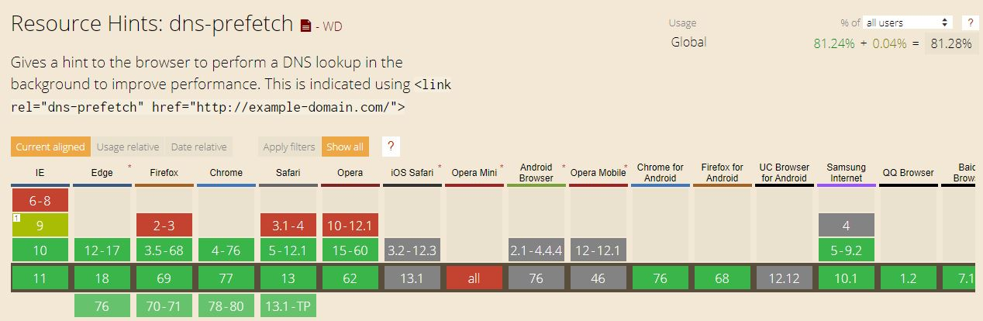
dns-prefetch: caniuse.com – Sept 9, 2019

Slide 21
preconnect

Slide 22
What resource hints are there? preconnect
preconnect does all the work necessary to establish a connection with a given domain including the DNS lookup, TCP handshake, and TLS negotiation, if you’re on https.
This hint comes into play when you do not know what specific requests you will be making to a domain, but you do know that you will be requesting resources from that domain.
Use it for domains you will need shortly as the browser incurs the expense of creating a connection with this hint.

Slide 23
preconnect: Benefits
Can mask high latency connections
Potential savings of several hundred milliseconds, per domain
Bar
DNS resolution occurs in the background
Save time when new, external resource requested (20-120ms)
Initiate resolution of resources the browser will not be aware of when parsing page

Slide 24
preconnect: Be aware of
Setting up and keeping a connection open is costly – both for a client and a server.
Use this tag for 4-6 domains at most.
The browser is not required to follow a <link rel=“preconnect”> instruction. This means it can decide not to set up a new connection.
Therefore, pages that use resources must still have <link>’s to those resources.

Slide 25
preconnect: How it works
<link rel=“preconnect” href=“//example.com”>
URL Encountered
Cache checked for domain
Cached copy not found
Domain resolved thru DNS request
Connection made
TCP handshake
Domain cached
TLS negotiation
Notes:
Begins the same as the dns-prefetch hint: when the browser encounters these URLs, it first checks its cache, and then, lacking a cached copy, resolves the domain to the associated IP address through a request from the DNS server.
preconnect next performs the TCP handshake and TLS negotiation, if using https, to establish a connection to the domain.
These requests happen in the background in a way that doesn’t block the rendering of the page.

Slide 26




preconnect: Example – JavaScript Issue
JavaScript file makes AJAX requests to api.my-app.com
api.my-app.com
my-app.com
1
2
Connection to domain occurs at runtime
Notes:
The top row of icons represents the order of execution. Moving from left to right, the website is loaded into the browser and ready for user interaction. JavaScript is then executed that fires off an AJAX request to an unconnected domain. Resolution of the request is delayed while browser awaits action from the API, which interrupts the user’s experience.
The bottom row of icons represents the actual or perceived performance from the user’s perspective. After the site is loaded in the browser, the user if off to the races. When then trigger the AJAX request to the API, things start to slow down (imagine that needed data is to be returned by the API and the user needs to see that data before deciding what to do next). The slow down is due to the browser having to perform the steps necessary to connect to the API in order to retrieve the data.

Slide 27

preconnect: Example – JavaScript Resolution
JavaScript file makes AJAX requests to api.my-app.com
api.my-app.com
my-app.com
3
4
1
HTML file
api.my-app.com
2
HTML contains,
<link rel=“preconnect” href=“api.my-app.com” />
Connection already made when page was parsed
Notes:
The top row of icons represents the order of execution. Moving from left to right, the website is loaded into the browser and ready for user interaction. JavaScript is then executed that fires off an AJAX request to an unconnected domain. Resolution of the request is delayed while browser awaits action from the API, which interrupts the user’s experience.
The bottom row of icons represents the actual or perceived performance from the user’s perspective. After the site is loaded in the browser, the user if off to the races. When then trigger the AJAX request to the API, things start to slow down (imagine that needed data is to be returned by the API and the user needs to see that data before deciding what to do next). The slow down is due to the browser having to perform the steps necessary to connect to the API in order to retrieve the data.

Slide 28
preconnect: 10,000 ft. view, sans preconnecting
page
page
page
CSS file using Google Font, Roboto
CSS file using Google Font, Roboto
page
page
page
CSS file using Google Font, Roboto
page
page
JavaScript file makes AJAX requests to api.my-app.com
JavaScript file makes AJAX requests to api.my-app.com
Notes:
Rotation of shapes is intentional and meant to reinforce the top-down view of a website which I am attempting to portray.
In this scenario, the Roboto font from Google is used in all three processing paths and appears in the leading page of all three paths.
The call to api.my-app.com occurs in two of the paths and always with the last page.

Slide 29
preconnect: 10,000 ft. view, preconnecting salvation
page
page
page
CSS file using Google Font, Roboto
HTML contains,
<link rel=“dns-prefetch” href=“api.my-app.com” />
<link rel=“preconnect” href=“fonts.googleapis.com” />
<link rel=“preconnect” href=“fonts.gstatic.com” />
JavaScript file makes AJAX requests to api.my-app.com
page
page
page
page
page
CSS file using Google Font, Roboto
JavaScript file makes AJAX requests to api.my-app.com
CSS file using Google Font, Roboto
Notes:
Rotation of shapes is intentional and meant to reinforce the top-down view of a website which I am attempting to portray.
The landing page aids the performance of all three of its child processing paths by kicking off the connections to the two Google Fonts domains ahead of the user navigating to those pages.
The landing page does not use any of the resources it prefetches, but triggering the connections of these domains does not impact it as the work is being done in the background. When the user navigates away from this page, work has already been started on connection to the resources that will be consumed by subsequent pages.

Slide 30
preconnect: When to use
For domains you will need in short time
Even if the full resource URL is unknown
Slightly speed up some 3rd party script or style
Notes:
If you have a third-party resource in the page that you really need to load sooner, add <link rel="preconnect" /> for that domain. It will instruct the browser to setup connection for that domain sooner.

Slide 31
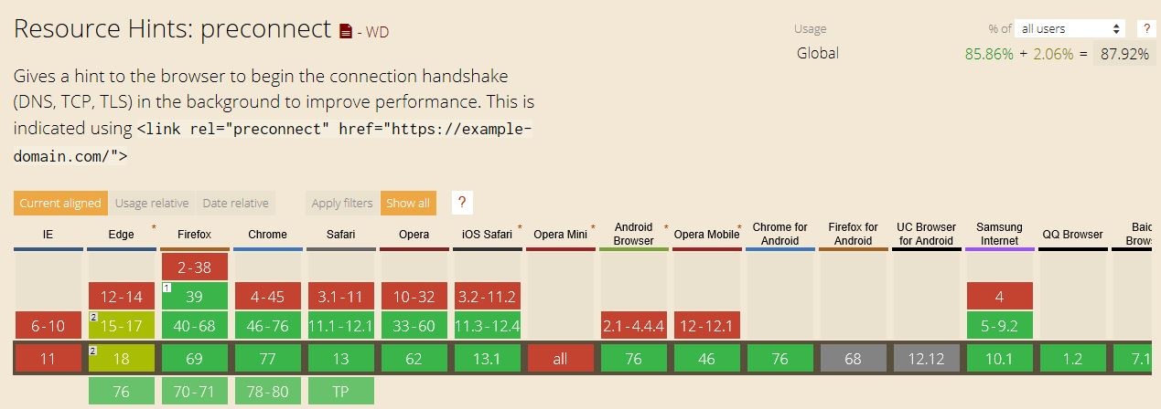
preconnect: caniuse.com – Oct. 22, 2019

Slide 32
prefetch

Slide 33
What resource hints are there? prefetch
prefetch asks the browser to download and cache a resource (like, a script or a stylesheet) in the background. Once a web page has finished loading and the idle time has passed, the browser begins downloading other resources
There is no same-origin restriction for link prefetching. Limiting prefetching to only URLs from the same server would not offer any increased browser security.
The browser doesn’t do anything with the resource after downloading it. Scripts aren’t executed, stylesheets aren’t applied. It’s just cached – so that when something else needs it, it’s available immediately

Slide 34
prefetch: Benefits
Loads with lowest priority on current page
Probably safe to use liberally
Preemptively loads assets for subsequent pages
HTTPS content can be prefetched

Slide 35
prefetch: Be aware of
No same-origin restriction for link prefetching
The browser is not required to follow the prefetch hint
Use the as attribute – it helps the browser prioritize and schedule the download properly
Only cacheable elements should be prefetched – anchor (<a>) tags are not prefetched
Mobile users
User data restrictions could apply – possibly costing them money
Do not use for urgently needed assets on current page
Notes:
Limiting prefetching to only URLs from the same server would not offer any increased browser security.
As the browser is not required to follow this hint, it is important to still have a link to required assets on the pages that will consume them.

Slide 36
prefetch: How it works
<link rel=“prefetch” href=“/library.js” as=“script”>
Current page
Asset downloaded as low priority
Asset cached
Script are not executed yet
Subsequent page
Scripts are executed now
Styles are not applied yet
Styles are applied now
Notes:
The download happens with a low priority, so it doesn’t interfere with more important resources on the current page.
The browser doesn’t do anything with the resource after downloading it. Scripts aren’t executed, stylesheets aren’t applied. It’s just cached – so that when something else needs it, it’s available immediately.

Slide 37
prefetch: Resource request sequence: issue
Page 1
Page 2
Page 3
Landing page
Uses PinkFuzzyBunnySlippers image
Uses PinkFuzzyBunnySlippers theme for styling
PinkFuzzyBunnySlippers image downloaded now
PinkFuzzyBunnySlippers CSS downloaded now
Notes:
In this scenario, resources are downloaded by the pages consuming them.

Slide 38
prefetch: Resource request sequence: resolution
HTML contains,
<link rel=“prefetch” href=“my-app.com/images/PFBS.jpg” as=“image” />
HTML contains,
<link rel=“prefetch” href=“my-app.com/styles/PFBS.css” as=“style” />
Page 1
Page 2
Page 3
Landing page
Uses PinkFuzzyBunnySlippers image
Uses PinkFuzzyBunnySlippers theme for styling
Notes:
In this sequence, each page that logically precedes another executes a prefetching of resources used by trailing page in order to expediate the loading of the trailing page.

Slide 39
prefetch: When to use
Assets used on other pages
Shifts loading time to speed rendering of that page
Not urgently needed assets
Use <link rel=“preload”> instead

Slide 40
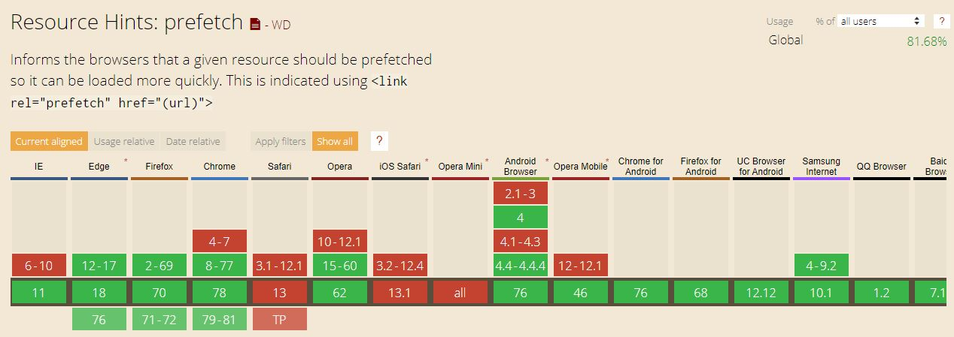
prefetch: caniuse.com – Oct. 28, 2019

Slide 41
preload

Slide 42
What resource hints are there? preload
preload is used to retrieve a resource that will be needed on the same page. Starting the load early in the page life-cycle ensures resources are available earlier and are less likely to block the page’s render.
preload is a mandatory and high-priority action for a resource that is necessary for the current navigation.
It is actually the only mandatory resource hint, so remember, “With great power comes great responsibility”.
Notes:
preload is like prefetch, with the difference that if prefetch is used to initiate a request for a resource that will be needed in a subsequent route, preload is used to prefetch a resource that will be needed in the same page.
Fonts are probably the most important thing that gets hidden in the CSS. They are critical for rendering the text on the page, but they don’t get loaded until browser is sure that they are going to be used. That check happens only after CSS has been parsed, and applied, and the browser has matched CSS rules to the DOM nodes. This happens late in the page loading process and it often results in an unnecessary delay in text rendering. You can avoid it by using the preload attribute when you link fonts.
The quote is Uncle Ben to Peter Parker.

Slide 43
preload: Benefits
Can jump the gun and start earlier loading of a needed resource for the current page after the page loads
Resources that are pointed to from inside CSS, like fonts or images
Resources that JavaScript can request, like JSON, imported scripts, or web workers
CSS files loaded by JavaScript (Critical CSS approach)
Larger images and video files
Notes:
Per the the Critical CSS approach, you split your CSS into two parts – critical (required for immediate rendering) and non-critical. With this approach, non-critical styles will start downloading only when JavaScript starts executing – which can be a few seconds after the first render. Instead of waiting for JS to execute, use <link rel="preload"> to initiate the download sooner.

Slide 44
preload: Be aware of
It is a hint that is compulsory for the browser
It is specific to the current page
Do not overuse it
Doing so will likely prevent the browser from scheduling everything smartly
Do not confuse with prefetch
Do not use if you do not immediately need a resource after the page loads
Set the as attribute
Browsers will use this attribute to determine the resource’s priority
Notes:
dns-prefetch is the younger brother of preconnect. prefetch is a distant cousin to preload.

Slide 45
preload: How it works
<link rel=“preload” href=“/library.js” as=“script”>
Current page
Resource downloaded early as high priority
Page renders
Resource is preloaded in cache
Still current page
Resource is available when required

Slide 46
preload: Page resource usage: issue
index.html
<head>
<link rel=“stylesheet” href=“style.css” />
</head>
/* style.css */
@font-face {
src: url(“comic-sans.woff2”) format(“woff2”);
}
By default, comic-sans.woff2 will start downloading only when style.css is fetched an applied.
Notes:
<link rel="preload"> will help when you know you’ll need a resource soon after loading the page, and you want to start loading it earlier.

Slide 47
preload: Page resource usage: resolution
Landing page
<head>
<link rel=“preload” href=“comic-sans.woff2” as=“font” />
<link rel=“stylesheet” href=“style.css” />
</head>
Instead of waiting for style.css to be fetched and applied, preload can be used to initiate the download of the font sooner.
/* style.css */
@font-face {
src: url(“comic-sans.woff2”) format(“woff2”);
}

Slide 48
preload: When to use
You need an asset for the current page – and soon
Allows you to start loading of an asset quicker than normal

Slide 49
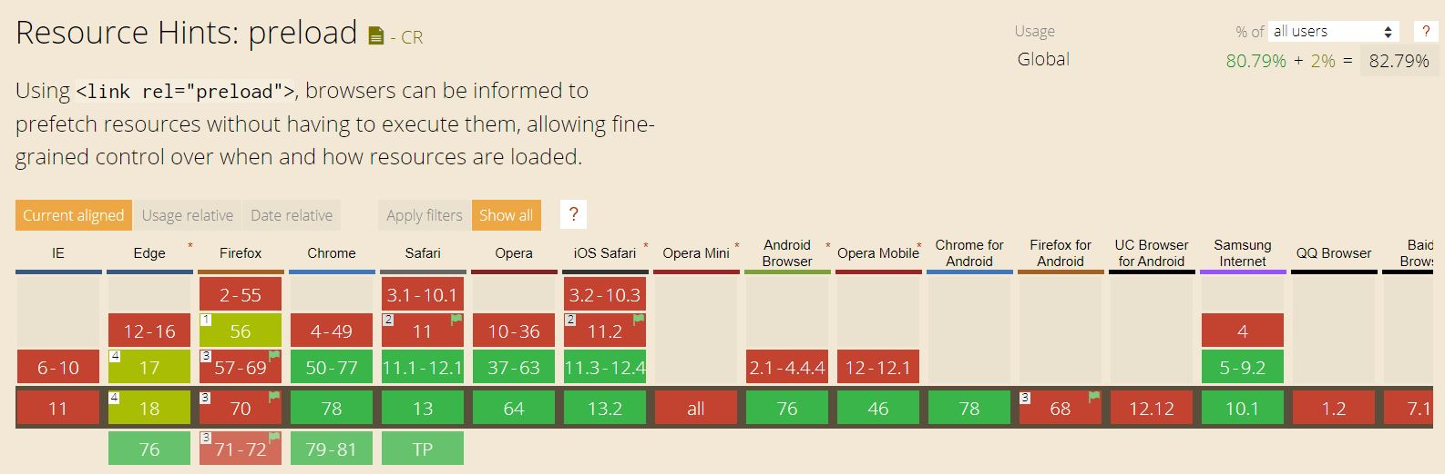
preload: caniuse.com – Oct. 30, 2019

Slide 50
prerender

Slide 51
What resource hints are there? prerender
Pre-rendering asks the browser to load a URL and render it in an invisible tab. When a user clicks on a link to that URL, the page should be rendered immediately. It’s helpful when you’re sure a user will visit a specific page next, and you want to render it faster.
As the browser executes scripts on the pre-rendered page, you may encounter some unexpected consequences such as analytics beacons being fired without the page being displayed. You can use the Page Visibility API to account for these situations.
Be aware that the decision to start the prerender process is left to the browser, and that the browser may choose not to start or to abandon the pre-render off your content based on a set of predefined rules.

Slide 52
prerender: Benefits
Queue up an entire page in the background

Slide 53
prerender: Be aware of
Not widely supported across browsers
Firefox has an implementation bug which has been open for 7+ years
Analytics beacons can be adversely affected
The Page Visibility API can be used to guard against scripts firing before they're rendered on the user's screen
Should be high degree of confidence that page will be viewed
Pre-rendering a page is very costly – both in terms of traffic and memory
The browser is not required to follow a <link rel=“prerender”> instruction.
Notes:
Despite (or because of?) its power, in 2019, <link rel="prerender"> has bad support in major browsers. Additionally, the browser is not required to follow a <link rel="prerender"> instruction. This means it can decide not to perform the prerender – e.g., if the memory is low, or the connection is slow.

Slide 54
preload: How it works
<link rel=“prerender” href=“https://my-app.com/pricing”>
Current page loading
Next page is loaded by the browser
Next page requested
Link to URL is clicked
Next page available
The next page renders immediately

Slide 55
prerender: Page request sequence: issue
Page 1
Page 2
Landing page
Browser renders Page 2, resources are loaded, the DOM is created, stylesheets are applied, and JavaScript is executed. User feels a disturbance in The Force
URL clicked to navigate to Page 2
Notes:
In this scenario, resources are downloaded by the individual pages consuming them.

Slide 56
prerender: Page request sequence: resolution
Page 1
Page 2
User clicks URL
Landing page
Landing page
HTML contains,
<link rel=“prerender” href=“//my-app.com/page2” />
Page is rendered immediately. User feels no disturbance in The Force
Resources are downloaded, the DOM created, styling applied, JavaScript executed
Page 2
Browser renders page in an invisible tab
Notes:
This is the nuclear option, as prerender gives us the ability to preemptively load all of the assets of a certain document.
This is like opening the URL in a hidden tab – all the resources are downloaded, the DOM is created, the page is laid out, the CSS is applied, the JavaScript is executed, etc. If the user navigates to the specified href, then the hidden page is swapped into view making it appear to load instantly.

Slide 57
prerender: When to use
You are really sure a user will got to some page next

Slide 58
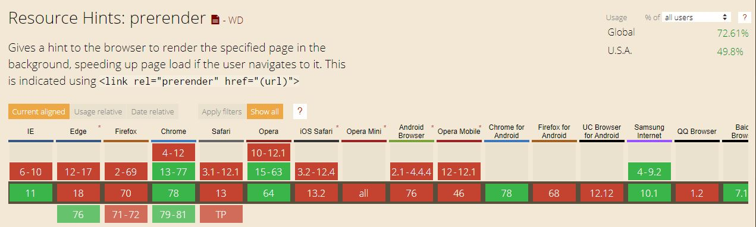
prerender: caniuse.com – Nov. 7, 2019
Notes:
Chrome doesn’t do a full render. Instead of a full render, Chrome makes a NoState Prefetch to save memory. This means Chrome downloads the page and all subsequent resources, but doesn’t render it or execute JavaScript.
Firefox and Safari don’t support this tag at all. This doesn’t break the specification, as browsers are not required to act on the tag; but this is still quite sad. Firefox has an implementation bug which has been open for 7 years; and there are reports that state Safari doesn’t support it too.

Slide 59
3. Hints Inside of Hints

Slide 60
The as Attribute

Slide 61
The as attribute
It helps the browser prioritize and schedule downloads properly by specifying type of content to be preloaded allowing the browser to:
Store in the cache for future requests reusing the resource, if appropriate
Apply the correct content security policy to the resource
Set the correct Accept request headers for it
Applies to loading of resources for a page, so the prefetch and preload resource hints
Notes:
The as attribute is a hint within a hint.

Slide 62
The as attribute Possible values
audio: Audio file, as typically used in <audio>
document: An HTML document intended to be embedded by a <frame> or <iframe>
embed: A resource to be embedded inside an <embed> element
fetch: Resource to be accessed by a fetch or XHR request, such as an ArrayBuffer or JSON file
font: Font file
image: Image file
object: A resource to be embedded inside an <object> element
script: JavaScript file
style: CSS stylesheet
track: WebVTT file
worker: A JavaScript web worker or shared worker
video: Video file, as typically used in <video>
Notes:
https://developer.mozilla.org/en-US/docs/Web/HTML/Preloading_content#What_types_of_content_can_be_preloaded
The full list of values the as attribute can take is governed by the Fetch spec — see request destinations.

Slide 63
The as attribute Examples
<link rel="prefetch" href="/style.css" as="style" />
<link rel="preload" href="comic-sans.woff2" as="font" />
<link rel="preload" href="main.js" as="script">

Slide 64
TOP DIVIDER

Slide 65
The pr Attribute

Slide 66
The pr attribute
Used to indicate the probability a given resource will be necessary
Can be used with every resource hint except preload
In a resource constrained device, the browser may decide to only execute high probability hints
expects a float value in the [0.0-1.0] range
Code example <link rel="prefetch" href="//example.com/next-page.html" pr="0.75">

Slide 67
BOTTOM DIVIDER

Slide 68
4. When To Use Resource Hints

Slide 69
When to use resource hints?
As developers, we know our applications better than the browser does. We can use our knowledge to inform the browser about core resources to expedite downloading of those resources.
Questions to ask yourself and your team are:
Which are the most critical resources on each page?
What actions trigger the download of additional content?
Which assets are on the critical rendering path?
Which are the most visited pages?
What is the journey your users take to conversion?
What is the frequency of a certain action?

Slide 70

When to use resource hints?
The greatest requirement for their use is…

Slide 71
Contact Info and Helpful Links

Slide 72
Helpful links used while researching
https://3perf.com/blog/link-rels/
https://medium.com/@luisvieira_gmr/html5-prefetch-1e54f6dda15d
https://css-tricks.com/prefetching-preloading-prebrowsing/
https://developer.mozilla.org/en-US/docs/Web/HTML/Preloading_content#What_types_of_content_can_be_preloaded

Slide 73
I am Tony Mangino
Email me at tm13089@gmail.com
This PowerPoint is on GitHub at foo
Find me on LinkedIn at www.linkedin.com/in/tonymangino

Slide 74


Slide 75
Title and Content Layout with Chart

Slide 76
Two Content Layout with Table
First bullet point here
Second bullet point here
Third bullet point here
Class | Group 1 | Group 2
Class 1 | 82 | 95
Class 2 | 76 | 88
Class 3 | 84 | 90

Slide 77
Title and Content Layout with SmartArt
Step 1 Title
Task description
Task description
Step 2 Title
Task description
Step 3 Title
Task description
Task description
Task description

Slide 78
Add a Slide Title - 1

Slide 79
Add a Slide Title - 2

Slide 80
Add a Slide Title - 3

Slide 82
Add a Slide Title - 4

Slide 83
Add a Slide Title - 5

